Slide 1


Slide 1
PROJECT MODULE-2
VISUALIZING DATA FOR DIFFERENT TEAM

Slide 2


Slide 2
STARTBUCKS COMPETITOR TEAM
Visualization for the nutrition comparison

Slide 3
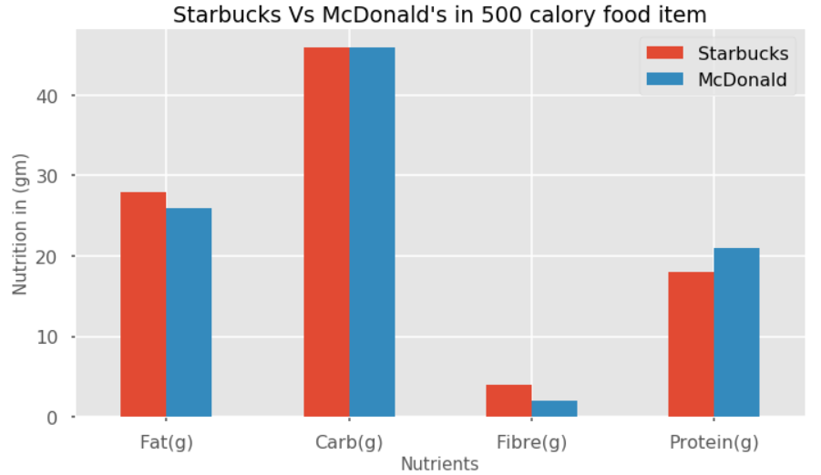
Slide 8
STARBUCKS FOOD
Starbucks Vs McDonald's in 500 calorie food item

Slide 4

Slide 15
THANK YOU!

